Slide 1
Digital Design &
Computer Architecture
Sarah Harris & David Harris
Chapter 1:
From Zero to One

Slide 2
Chapter 1 :: Topics
The Art of Managing Complexity
Number Systems
Binary Numbers
Hexadecimal Numbers
Bits, Bytes, Nibbles
Addition
Signed Numbers
Extension
Logic Gates
Logic Levels
CMOS Transistors
Transistor-Level Gate Design
Power Consumption

Slide 3
Chapter 1: From Zero to One
The Art of
Managing Complexity

Slide 4
The Art of Managing Complexity
How do we design things that are too big to fit in one person’s head at once?
Abstraction
Discipline
The Three –y’s
Hierarchy
Modularity
Regularity

Slide 5
Abstraction
Hiding details when they aren’t important

Slide 6
Discipline
Intentionally restrict design choices
Example: Digital discipline
Discrete voltages instead of continuous
Simpler to design than analog circuits – can build more sophisticated systems
Digital systems replacing analog predecessors: i.e., digital cameras, digital television, cell phones, CDs

Slide 7
The Three -y’s
Hierarchy
A system divided into modules and submodules
Modularity
Having well-defined functions and interfaces
Regularity
Encouraging uniformity, so modules can be easily reused

Slide 8
Example: Model T Ford
Famous early (1908) example of interchangeable parts.
Most previous cars were hand-crafted
by skilled tradesmen.
Mass production on moving assembly
lines greatly reduced cost.
Henry Ford:
I will build a motor car for the great multitude. It will be large enough for the family, but small enough for the individual to run and care for. It will be constructed of the best materials, by the best men to be hired, after the simplest designs that modern engineering can devise. But it will be so low in price that no man making a good salary will be unable to own one – and enjoy with his family the blessing of hours of pleasure in God's great open spaces.
en.wikipedia.org/wiki/Ford_Model_T#/media/
File:1925_Ford_Model_T_touring.jpg

Slide 9
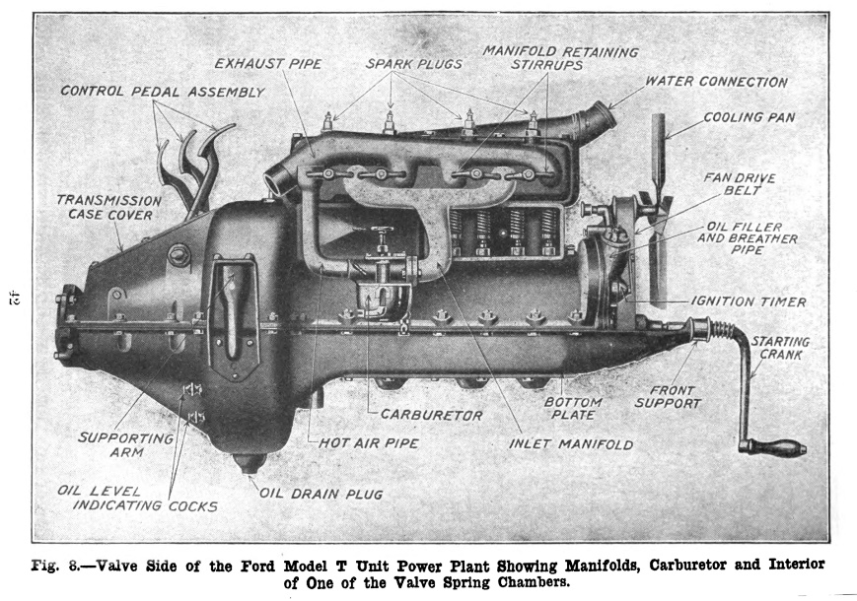
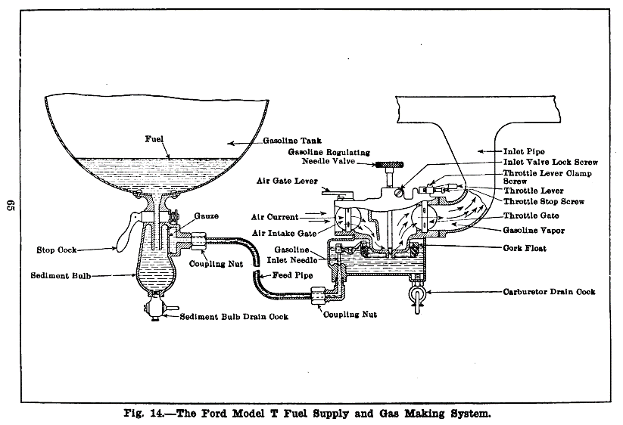
Example: Model T Ford
Hierarchy
Car has chassis, wheels, seats, engine.
Engine has cylinders, spark plugs, exhaust, carburetor.
Carburator has air intake, inlet needle, feed pipe, coupling nut.
https://en.wikipedia.org/wiki/Ford_Model_T_engine#/media/File:Pagé_1917_Model_T_Ford_Car_Figure_08.png
https://en.wikipedia.org/wiki/Ford_Model_T_engine#/media/File:Pagé_1917_Model_T_Ford_Car_Figure_14.png

Slide 10
Example: Model T Ford
Modularity
Function of coupling nut:
Hold fuel line to intake elbow
Prevent leaks
Easily removable
Interface of coupling nut:
Standardized diameter, thread pitch, torque
Regularity
Interchangeable parts
Standard nut could be purchased from many suppliers
“Any customer can have a car painted any color that he wants so long as it is black.” - Henry Ford

Slide 11
The Digital Abstraction
Most physical variables are continuous
Voltage on a wire
Frequency of an oscillation
Position of a mass
Digital abstraction considers discrete subset of values

Slide 12
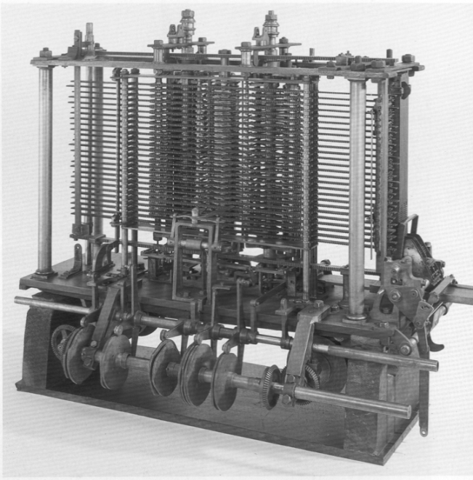
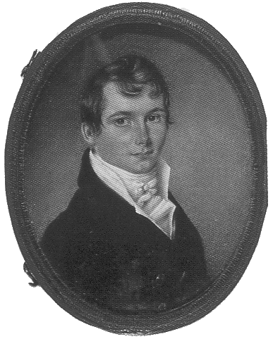
The Analytical Engine
Designed by Charles Babbage from 1834 – 1871
Considered to be the first digital computer
Built from mechanical gears, where each gear represented a discrete value (0-9)
Babbage died before finishing it
Notes:
Babbage found errors in manually calculated tables “I wish to God these calculations had been executed by steam.”
Babbage kept changing designs before getting them working.
Precision components were too difficult to manufacture in the shops of the day.
British Government granted over 17,000 pounds (each worth a pound of silver at the time), a princely sum, before pulling plug.
Babbage died a bitter and broken man.
Two working engines were built from his plans in 1991 and are on display in the Computer History Museum and the Science Museum.

Slide 13
Digital Discipline: Binary Values
Two discrete values:
1’s and 0’s
1, TRUE, HIGH
0, FALSE, LOW
1 and 0: voltage levels, rotating gears, fluid levels, etc.
Digital circuits use voltage levels
0: low voltage (GND)
1: high voltage (V_{DD})
Bit: Binary digit

Slide 14
Chapter 1: From Zero to One
Number Systems:
Binary Numbers

Slide 15
Number Systems
Decimal numbers
Binary numbers
Decimal numbers in digital systems mean any base 10 numbers, not just those with a decimal point.

Slide 16
Counting in Binary
Binary Decimal
0 0
1 1
10 2
11 3
4
5
…

Slide 17
Powers of Two
2⁰ = 1
2¹ = 2
2² = 4
2³ = 8
2⁴ = 16
2⁵ = 32
2⁶ = 64
2⁷ = 128
2⁸ = 256
2⁹ = 512
2¹⁰ = 1024
2¹¹ = 2048
2¹² = 4096
2¹³ = 8192
2¹⁴ = 16384
2¹⁵ = 32768
Handy to memorize

Slide 18
Number Conversion
Binary to decimal conversion:
Convert 10011₂ to decimal
16×1 + 8×0 + 4×0 + 2×1 + 1×1 = 19₁₀
Decimal to binary conversion:
Convert 47₁₀ to binary
32×1 + 16×0 + 8×1 + 4×1 + 2×1 + 1×1 = 101111₂

Slide 19
Decimal to Binary Conversion
Two methods:
Method 1: Find the largest power of 2 that fits, subtract and repeat
Method 2: Repeatedly divide by 2, remainder goes in next most significant bit

Slide 20
Decimal to Binary Conversion
53₁₀
Method 1: Find the largest power of 2 that fits, subtract and repeat
53₁₀ 32×1
53-32 = 21 16×1
21-16 = 5 4×1
5-4 = 1 1×1 = 110101₂
Method 2: Repeatedly divide by 2, remainder goes in next most significant bit
53₁₀ = 53/2 = 26 R1
26/2 = 13 R0
13/2 = 6 R1
6/2 = 3 R0
3/2 = 1 R1
1/2 = 0 R1 = 110101₂

Slide 21
Binary Values and Range
N-digit decimal number
How many values? 10^{N}
Range? [0, 10^{N} - 1]
Example: 3-digit decimal number:
10³ = 1000 possible values
Range: [0, 999]
N-bit binary number
How many values? 2^{N}
Range: [0, 2^{N} - 1]
Example: 3-digit binary number:
2³ = 8 possible values
Range: [0, 7] = [000₂ to 111₂]
Notes:
There are 10 kinds of people in this world: those who can count in binary and those who can’t.

Slide 22
Chapter 1: From Zero to One
Number Systems:
Hexadecimal Numbers

Slide 23
Hexadecimal Numbers
Hex Digit | Decimal Equivalent | Binary Equivalent
0 | 0 | 0000
1 | 1 | 0001
2 | 2 | 0010
3 | 3 | 0011
4 | 4 | 0100
5 | 5 | 0101
6 | 6 | 0110
7 | 7 | 0111
8 | 8 | 1000
9 | 9 | 1001
A | 10 | 1010
B | 11 | 1011
C | 12 | 1100
D | 13 | 1101
E | 14 | 1110
F | 15 | 1111

Slide 24
Hexadecimal Numbers
Base 16
Shorthand for binary

Slide 25
Hexadecimal to Binary Conversion
Hexadecimal to binary conversion:
Convert 4AF₁₆ (also written 0x4AF) to binary
0100 1010 1111₂
Hexadecimal to decimal conversion:
Convert 4AF₁₆ to decimal
16²×4 + 16¹×10 + 16⁰×15 = 1199₁₀

Slide 26
Hexadecimal and Binary Prefixes
Hard to write subscripts in text files
Some programming languages uses prefixes
Hex: 0x
0x23AB = 23AB₁₆
Binary: 0b
0b1101 = 1101₂

Slide 27
Chapter 1: From Zero to One
Number Systems:
Bytes, Nibbles,
& All That Jazz

Slide 28
Bits, Bytes, Nibbles…
Byte: 8 bits
Represents one of _____ values
[__, ___]
Nibble: 4 bits
Represents one of _____ values
[__, ___]
One binary digit is __ bit
One hex digit is ___ bits or ___ nibble
Two hex digits make ___ byte
Most significant on left
Least significant on right

Slide 29
Large Powers of Two
2¹⁰ = 1 kilo ≈ 10³ (1024)
2²⁰ = 1 mega ≈ 10⁶ (1,048,576)
2³⁰ = 1 giga ≈ 10⁹ (1,073,741,824)
2⁴⁰ = 1 tera ≈ 10¹²
2⁵⁰ = 1 peta ≈ 10¹⁵
2⁶⁰ = 1 exa ≈ 10¹⁸

Slide 30
Estimating Powers of Two
What is the value of 2²⁴?
2⁴ × 2²⁰ ≈ 16 million
How large of a value can a 32-bit integer variable represent?
2² × 2³⁰ ≈ 4 billion

Slide 31
Chapter 1: From Zero to One
Number Systems:
Addition

Slide 32
Addition
Decimal
Binary

Slide 33
Binary Addition Examples
Add the following 4-bit binary numbers
Add the following 4-bit binary numbers

Slide 34
Overflow
Digital systems operate on a fixed number of bits
Overflow: when result is too big to fit in the available number of bits
See previous example of 11 + 6

Slide 35
Chapter 1: From Zero to One
Number Systems:
Signed Numbers

Slide 36
Signed Binary Numbers
Sign/Magnitude Numbers
Two’s Complement Numbers

Slide 37
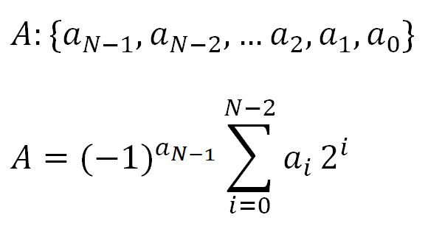
Sign/Magnitude Numbers
1 sign bit, N-1 magnitude bits
Sign bit is the most significant (left-most) bit
Positive number: sign bit = 0
Negative number: sign bit = 1
Example, 4-bit sign/mag representations of ± 6:
+6 = 0110
- 6 = 1110
Range of an N-bit sign/magnitude number:
[-(2^{N-1}-1), 2^{N-1}-1]

Slide 38
Sign/Magnitude Numbers
Problems:
Addition doesn’t work, for example -6 + 6:
1110
+ 0110
10100 (wrong!)
Two representations of 0 (± 0):
1000
0000

Slide 39
Two’s Complement Numbers
Don’t have same problems as sign/magnitude numbers:
Addition works
Single representation for 0

Slide 40
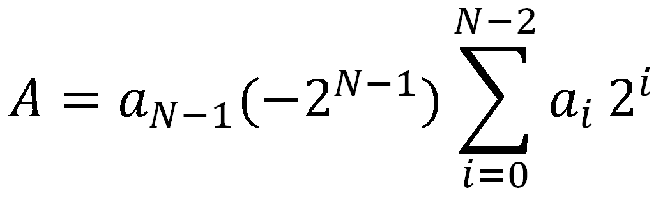
Two’s Complement Numbers
msb has weight of -2^{N-1}
Most positive 4-bit number: 0111
Most negative 4-bit number: 1000
The most significant bit still indicates the sign (1 = negative, 0 = positive)
Range of an N-bit two’s complement number:
[-(2^{N-1}), 2^{N-1}-1]
+

Slide 41
Reversing the Sign
Reverse the sign of a two’s complement number
Method:
Invert the bits
Add 1
Example: Reverse the sign of 3₁₀ = 0011₂
1100
+ 1
1101 = -3₁₀
Historically, this reversing the sign method has been called: “Taking the Two’s complement”.
But this terminology can be confusing, so we instead we call it “reversing the sign”.

Slide 42
Two’s Complement Examples
Reverse the sign of 6₁₀ = 0110₂
1001
+ 1
1010₂ = -6₁₀
What is the decimal value of the two’s complement number 1001₂?
0110
+ 1
0111₂ = 7₁₀, so 1001₂ = -7₁₀

Slide 43
Two’s Complement Addition
Add 6 + (-6) using two’s complement numbers
Add -2 + 3 using two’s complement numbers

Slide 44
Subtraction
Subtract a 2’s complement number by reversing the sign and adding.
Reverse sign by taking 2’s complement
Ex: 3 – 5 = 3 + (-5)

Slide 45
Number System Comparison
Number System | Range
Unsigned | [0, 2^{N}-1]
Sign/Magnitude | [-(2^{N-1}-1), 2^{N-1}-1]
Two’s Complement | [-2^{N-1}, 2^{N-1}-1]
For example, 4-bit representation:

Slide 46
Chapter 1: From Zero to One
Number Systems:
Extension

Slide 47
Increasing Bit Width
Extend number from N to M bits (M > N) :
Sign-extension for 2’s complement numbers
Zero-extension for unsigned numbers

Slide 48
Sign-Extension
Sign bit copied to msb’s
Number value is same
Example 1:
4-bit representation of 3 = 0011
8-bit sign-extended value: 00000011
Example 2:
4-bit representation of -5 = 1011
8-bit sign-extended value: 11111011

Slide 49
Zero-Extension
Zeros copied to msb’s
Value changes for negative numbers
Example 1:
4-bit value = 0011 = 3₁₀
8-bit zero-extended value: 00000011 = 3₁₀
Example 2:
4-bit value = 1011 = -5₁₀
8-bit zero-extended value: 00001011 = 11₁₀

Slide 50
Chapter 1: From Zero to One
Logic Gates

Slide 51
Logic Gates
Perform logic functions:
inversion (NOT), AND, OR, NAND, NOR, etc.
Single-input:
NOT gate, buffer
Two-input:
AND, OR, XOR, NAND, NOR, XNOR
Multiple-input

Slide 52
Single-Input Logic Gates

Slide 53
Two-Input Logic Gates

Slide 54
More Two-Input Logic Gates

Slide 55
Multiple-Input Logic Gates
Truth table rows
are listed in
binary order.
Multi-input XOR: Odd parity

Slide 56
SystemVerilog Description
module gates(input logic a, b, c,
output logic y1, y2, y3, y4, y5);
not g1(y1, a);
and g2(y2, a, b);
or g3(y3, a, b, c);
nand g4(y4, b, c);
xor g5(y5, a, c);
endmodule

Slide 57
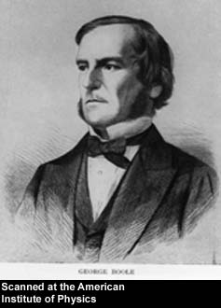
George Boole, 1815-1864
Born to working class parents
Taught himself mathematics and joined the faculty of Queen’s College in Ireland
Wrote An Investigation of the Laws of Thought (1854)
Introduced binary variables
Introduced the three fundamental logic operations: AND, OR, and NOT

Slide 58
Chapter 1: From Zero to One
Logic Levels

Slide 59
Logic Levels
Discrete voltages represent 1 and 0
For example:
0 = ground (GND) or 0 volts
1 = V_{DD} or 5 volts
What about 4.99 volts? Is that a 0 or a 1?
What about 3.2 volts?

Slide 60
Logic Levels
Range of voltages for 1 and 0
Different ranges for inputs and outputs to allow for noise

Slide 61
What is Noise?
Anything that degrades the signal
E.g., resistance, power supply noise, coupling to neighboring wires, etc.
Example: a gate (driver) outputs 5 V but, because of resistance in a long wire, receiver gets 4.5 V

Slide 62
The Static Discipline
With logically valid inputs, every circuit element must produce logically valid outputs
Use limited ranges of voltages to represent discrete values

Slide 63
Noise Margins

Slide 64
Noise Margins
High Noise Margin: NM_{H} = V_{OH} – V_{IH}
Low Noise Margin: NM_{L} = V_{IL} – V_{OL}

Slide 65
DC Transfer Characteristics
Ideal Buffer: Real Buffer:
NM_{H} = NM_{L} = V_{DD}/2
NM_{H}, NM_{L} < V_{DD}/2

Slide 66
DC Transfer Characteristics

Slide 67
V_{DD} Scaling
In 1970’s and 1980’s, V_{DD} = 5 V
V_{DD} has dropped
Avoid frying tiny transistors
Save power
3.3 V, 2.5 V, 1.8 V, 1.5 V, 1.2 V, 1.0 V, …
Be careful connecting chips with different supply voltages

Slide 68
V_{DD} Scaling
In 1970’s and 1980’s, V_{DD} = 5 V
V_{DD} has dropped
Avoid frying tiny transistors
Save power
3.3 V, 2.5 V, 1.8 V, 1.5 V, 1.2 V, 1.0 V, …
Be careful connecting chips with different supply voltages
Chips operate because they contain magic smoke
Proof: if the magic smoke is let out, the chip stops working

Slide 69
Logic Family Examples
Logic Family | V_{DD} | V_{IL} | V_{IH} | V_{OL} | V_{OH}
TTL | 5 (4.75 - 5.25) | 0.8 | 2.0 | 0.4 | 2.4
CMOS | 5 (4.5 - 6) | 1.35 | 3.15 | 0.33 | 3.84
LVTTL | 3.3 (3 - 3.6) | 0.8 | 2.0 | 0.4 | 2.4
LVCMOS | 3.3 (3 - 3.6) | 0.9 | 1.8 | 0.36 | 2.7

Slide 70
Chapter 1: From Zero to One
CMOS Transistors

Slide 71
Transistors
Logic gates built from transistors
3-ported voltage-controlled switch
2 ports connected depending on voltage of 3rd
d and s are connected (ON) when g is 1

Slide 72
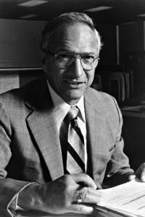
Robert Noyce, 1927-1990
Nicknamed “Mayor of Silicon Valley”
Cofounded Fairchild Semiconductor in 1957
Cofounded Intel in 1968
Co-invented the integrated circuit

Slide 73
Silicon
Transistors built from silicon, a semiconductor
Pure silicon is a poor conductor (no free charges)
Doped silicon is a good conductor (free charges)
n-type (free negative charges, electrons)
p-type (free positive charges, holes)

Slide 74
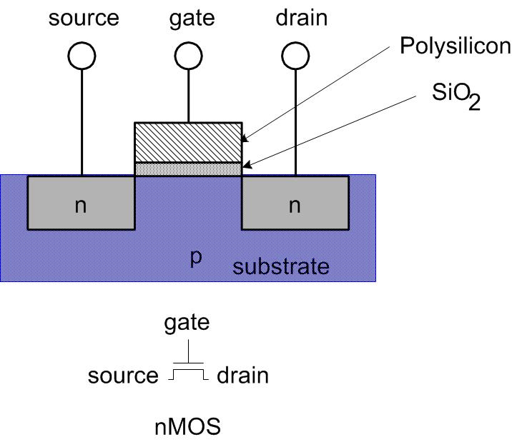
MOS Transistors
Metal oxide silicon (MOS) transistors:
Polysilicon (used to be metal) gate
Oxide (silicon dioxide) insulator
Doped silicon

Slide 75
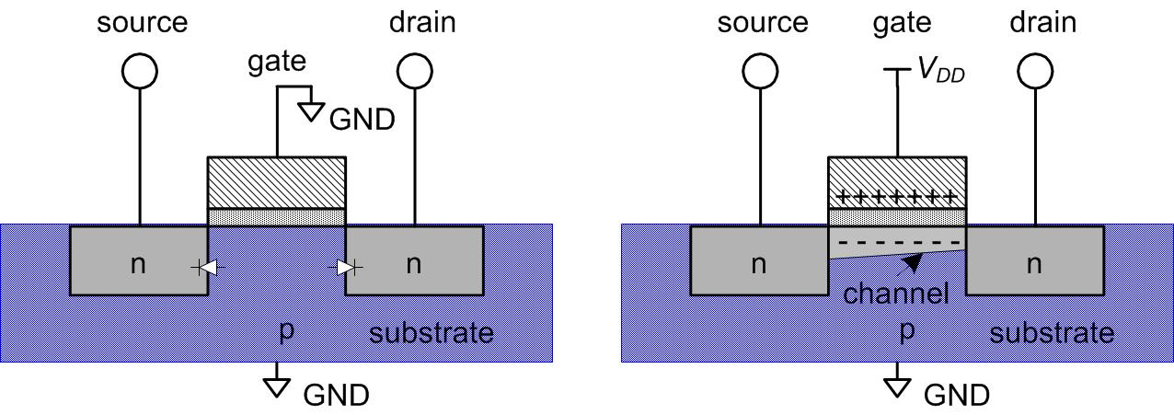
Transistors: nMOS
Gate = 0
OFF (no connection between source and drain)
Gate = 1
ON (channel between source and drain)

Slide 76
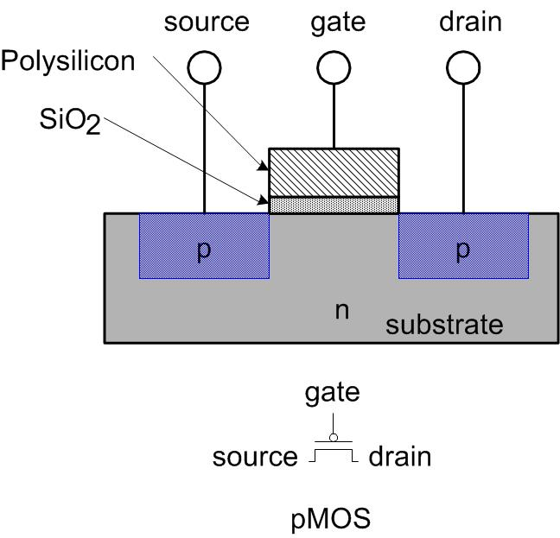
Transistors: pMOS
pMOS transistor is opposite
ON when Gate = 0
OFF when Gate = 1

Slide 77
Transistor Function

Slide 78
Transistor Function
nMOS: pass good 0’s, so connect source to GND
pMOS: pass good 1’s, so connect source to V_{DD}

Slide 79
Chapter 1: From Zero to One
Gates from Transistors

Slide 80
CMOS Gates: NOT Gate
A | P1 | N1 | Y
0 | ON | OFF | 1
1 | OFF | ON | 0

Slide 81
CMOS Gates: NAND Gate
A | B | P1 | P2 | N1 | N2 | Y
0 | 0 | ON | ON | OFF | OFF | 1
0 | 1 | ON | OFF | OFF | ON | 1
1 | 0 | OFF | ON | ON | OFF | 1
1 | 1 | OFF | OFF | ON | ON | 0

Slide 82
CMOS Gate Structure

Slide 83
NOR3 Gate
How do you build a three-input NOR gate?

Slide 84
AND2 Gate
How do you build a two-input AND gate?

Slide 85
Transmission Gates
nMOS pass 1’s poorly
pMOS pass 0’s poorly
Transmission gate is a better switch
passes both 0 and 1 well
When EN = 1, the switch is ON:
EN = 0 and A is connected to B
When EN = 0, the switch is OFF:
A is not connected to B

Slide 86
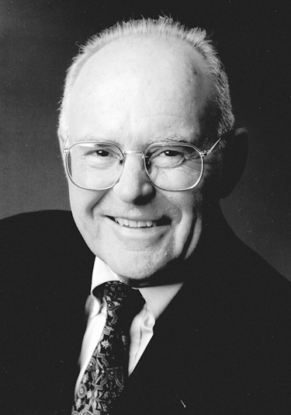
Gordon Moore, 1929-
Cofounded Intel in 1968 with Robert Noyce.
Moore’s Law: number of transistors on a computer chip doubles every year (observed in 1965)
Since 1975, transistor counts have doubled every two years.
Corollaries: transistors get faster and lower power

Slide 87
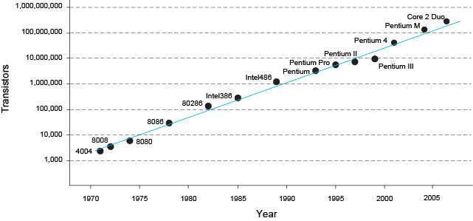
Moore’s Law
“If the automobile had followed the same development cycle as the computer, a Rolls-Royce would today cost $100, get one million miles to the gallon, and explode once a year . . .” (Robert Cringely, Infoworld)
– Robert Cringley

Slide 88
Chapter 1: From Zero to One
Power Consumption

Slide 89
Power Consumption
Power = Energy consumed per unit time
Dynamic power consumption
Static power consumption

Slide 90
Dynamic Power Consumption
Power to charge transistor gate capacitances
Energy required to charge a capacitance, C, to V_{DD} is CV_{DD}²
Circuit running at frequency f (f cycles per second)
Capacitor is charged α times per cycle (discharging from 1 to 0 is free)
Dynamic power consumption:
P_{dynamic} = αCV_{DD}²f

Slide 91
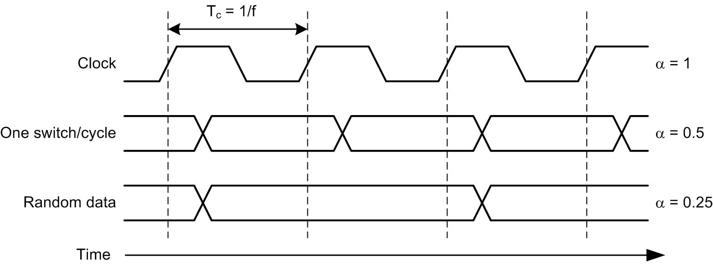
Activty Factor α
α is the fraction of cycles that cap is charged
Clock α = 1
Data switching once per cycle α = 0.5
Random data α = 0.25
Typical data α = 0.1

Slide 92
Static Power Consumption
Power consumed when no gates are switching
Caused by the quiescent supply current, I_{DD} (also called the leakage current)
Static power consumption:
P_{static} = I_{DD}V_{DD}

Slide 93
Units
Chips have tiny capacitances, small currents, and high frequencies.
Unit | Prefix | Value
Tera | T | 10¹²
Giga | G | 10⁹
Mega | M | 10⁶
Kilo | K | 10³
Mili | m | 10⁻³
Micro | μ | 10⁻⁶
Nano | n | 10⁻⁹
Pico | p | 10⁻¹²
Femto | f | 10⁻¹⁵

Slide 94
Power Consumption Example
Estimate the power consumption of a mobile phone running Angry Birds
V_{DD} = 0.8 V
C = 5 nF
f = 2 GHz
α = 0.1
I_{DD} = 100 mA
P = αCV_{DD}²f + I_{DD}V_{DD}
= (0.1)(5 nF)(0.8 V)²(2 GHz) + (100 mA)(0.8 V)
= (0.64 + 0.08) W ≈ 0.72 W

Slide 95
Power Consumption Example
If the phone has a 8 W-hr battery, estimate its battery life sitting idle in your pocket.
V_{DD} = 0.8 V
I_{DD} = 100 mA
P_{static} = I_{DD}V_{DD} = 0.08 W
Battery life = Capacity / Consumption
= (8 W-hr) / (0.08 W) = 100 hr (4 days)

Slide 96
About these Notes
Digital Design and Computer Architecture Lecture Notes
© 2021 Sarah Harris and David Harris
These notes may be used and modified for educational and/or non-commercial purposes so long as the source is attributed.

